Slide 1
Why Do RSL Fans Cheer Longer Than Utah Jazz Fans?
Tom Coe, Darren Rou, Joey Brignone
CS 3130
April 29, 2022

Slide 2
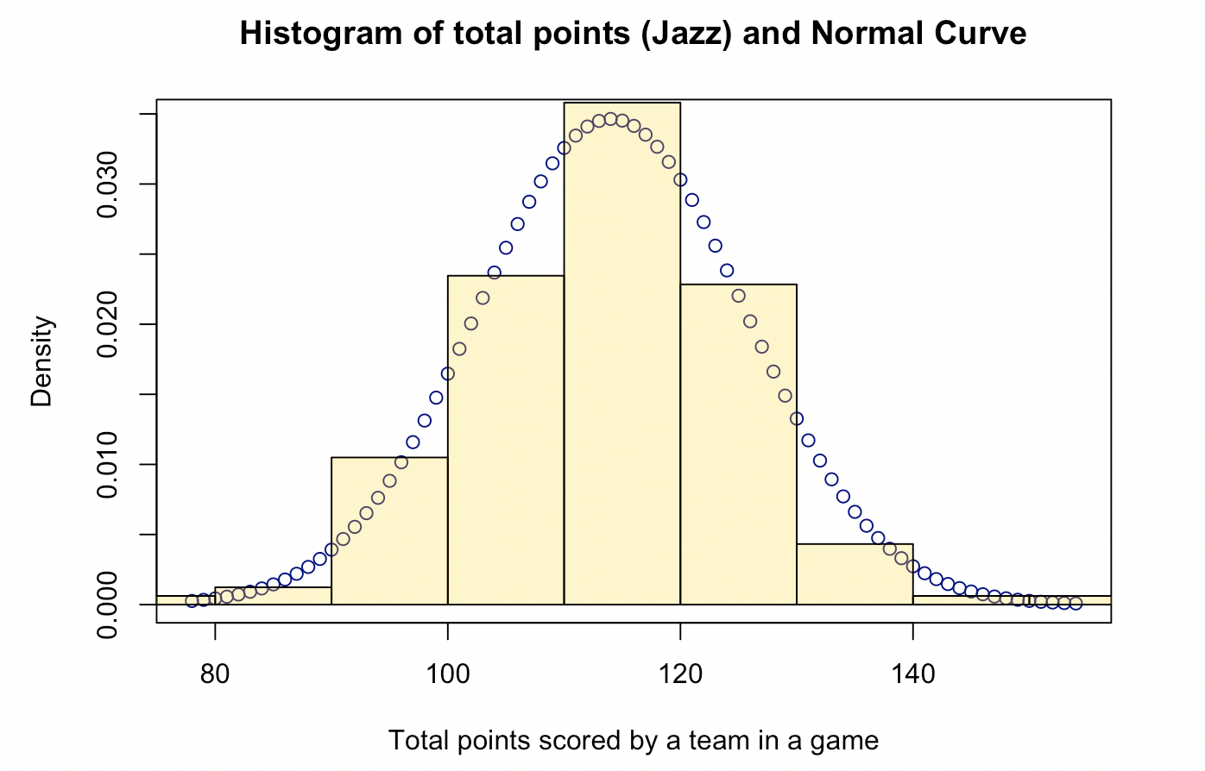
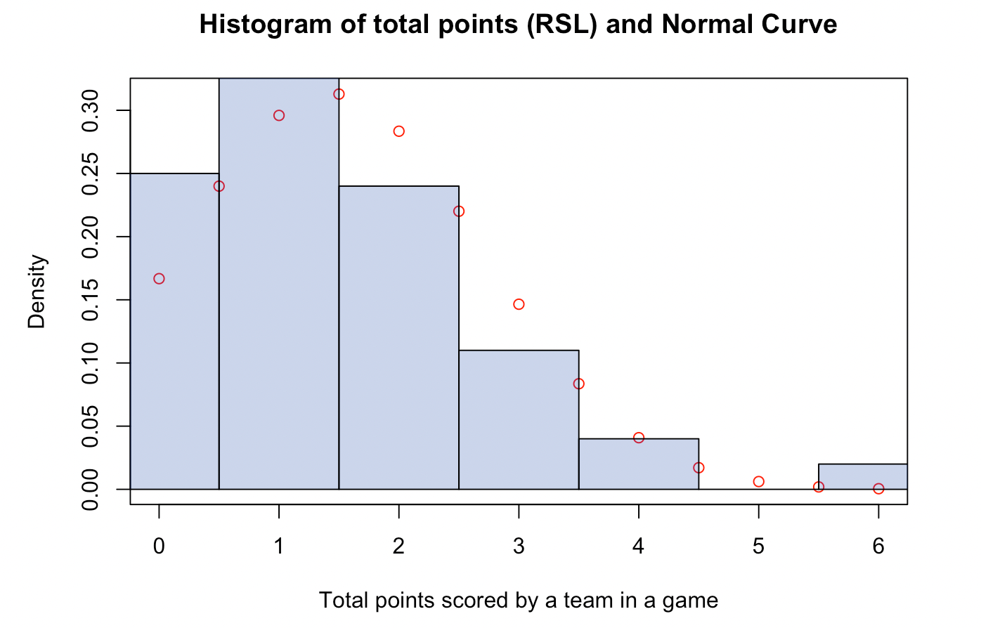
Point Histograms
Sample size (Jazz): 162 Sample size(RSL): 100
Sample mean(Jazz): 114 points Sample mean(RSL): 1.43 points
Notes:
Points totals are approximately normal for both the Utah Jazz and RSL. These histograms suggest that Jazz points totals are usually far greater than RSL point totals.

Slide 3
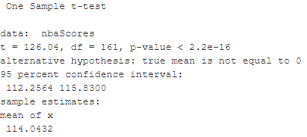
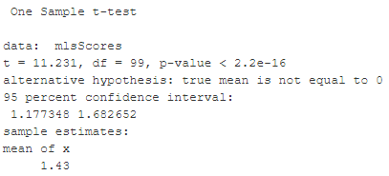
Scoring T-test Results
Good evidence shows the Jazz total score mean to be 112.3-115.8
Good evidence shows the RSL total score mean to be 1.2-1.7
Using these numbers on average 1 point scored by RSL is worth at least 67 points and at most 98 points.
Jazz Scores t-test
RSL Scores t-test

Slide 4
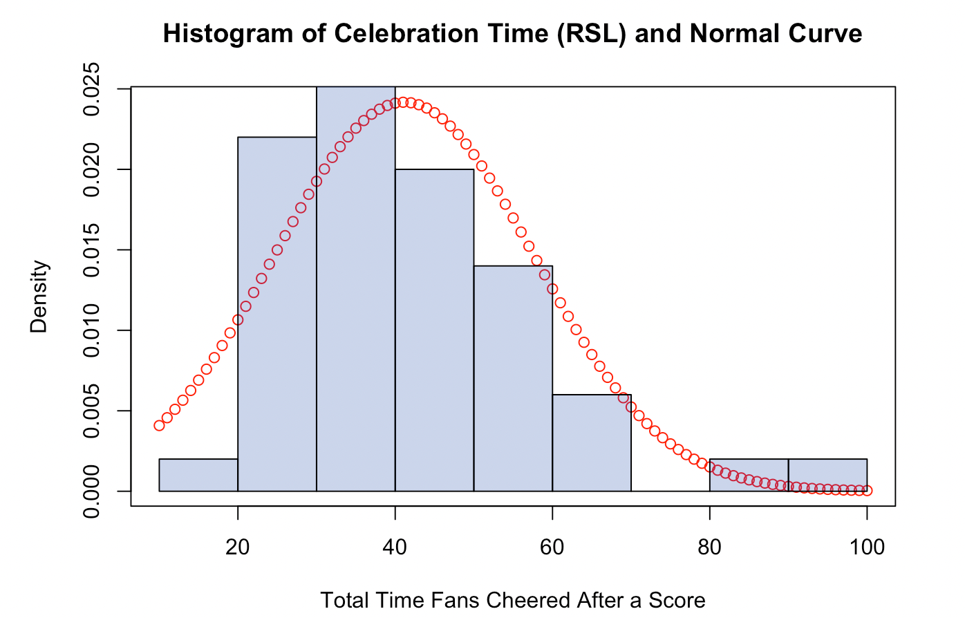
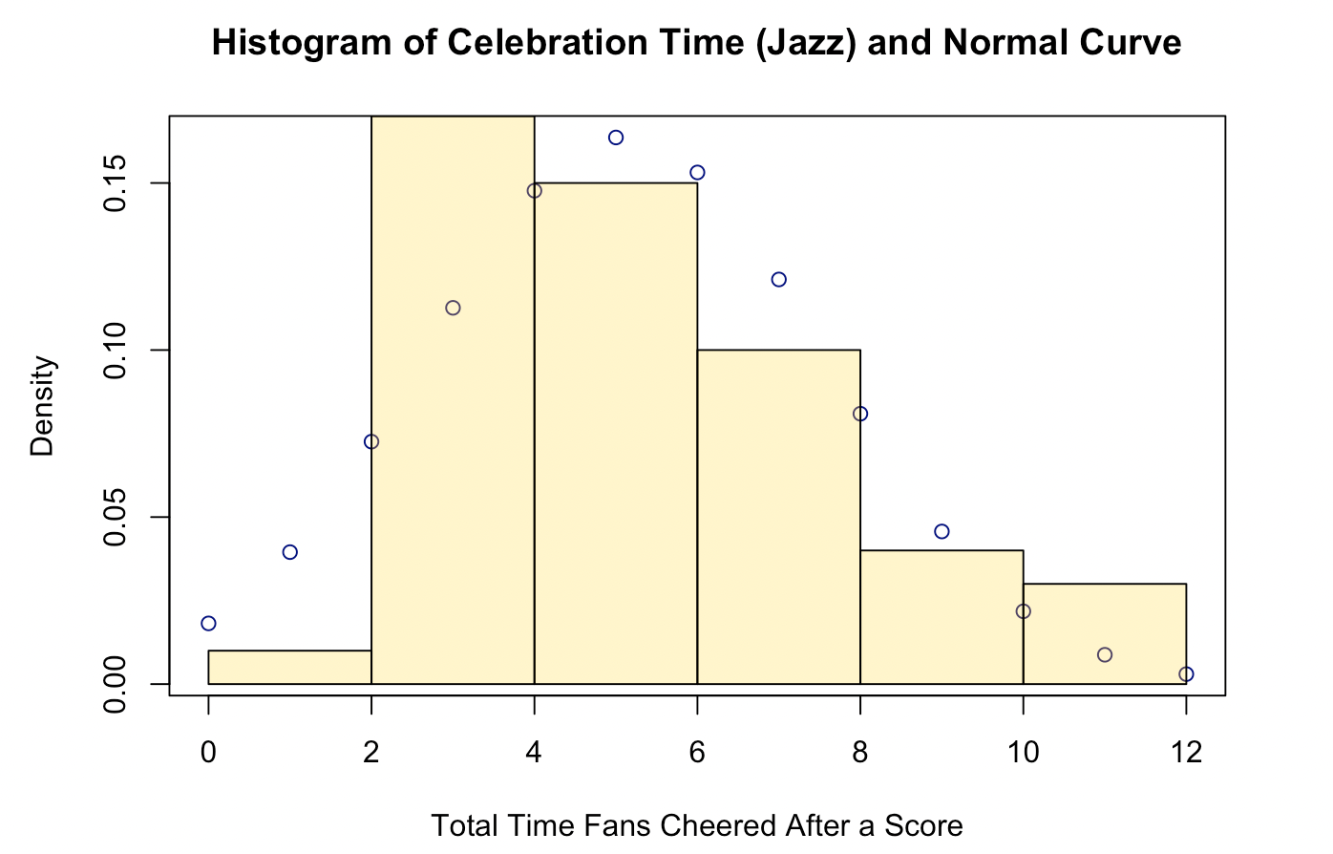
Celebration Times Histograms
Sample size (RSL): 50 Sample size(Jazz): 50
Sample mean(RSL): 41.1 seconds Sample mean(Jazz): 5.1 seconds
Notes:
After seeing that Jazz games usually have more total points, we went and watched some RSL and Jazz games and used a stopwatch to time the fans’ celebrations. Even though there was an element of error possible, the celebration times we recorded came out to be fairly normally distributed, as we can see in these histograms. <Read means>

Slide 5
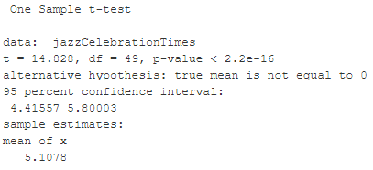
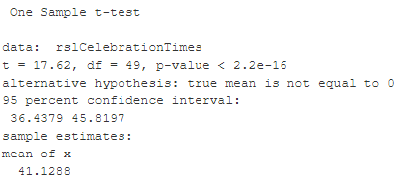
Celebration Time
T-test Results
Decent evidence shows that on average Jazz fans celebrate for 4.42-5.8 seconds after a point is scored.
Decent evidence shows that on average RSL fans celebrate for 36.4-45.8 seconds after a point is scored.
This equated to RSL fans cheering roughly 6.3-10.4 times longer on average.
Jazz Fan Celebration t-test
RSL Fan Celebration t-test
Notes:
As we can see here, compared to Jazz fans, RSL fans seem to celebrate for much longer duration: about 40 seconds on average. Dividing numbers arounds gives the result that RSL fans celebrate about 6 to 10 times longer on average. So it is interesting that RSL fans celebrate longer. The p-values are very small, indicating strong evidence.

Slide 6
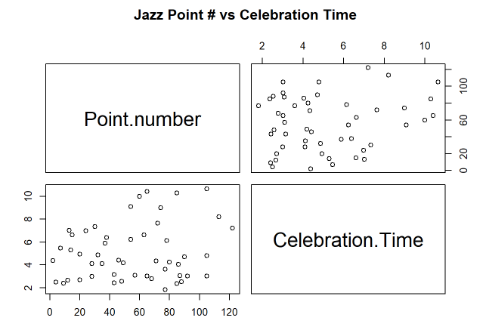
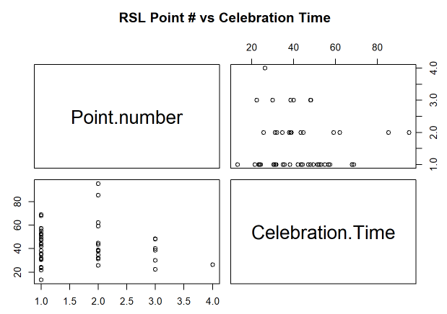
There is little to no correlation between point number and celebration time.
Notes:
We wanted to see if the number of points in the game the team had an effect on the celebration time. Point number refers to the order which the points are scored, telling us somewhat when the points were scored per game. You would assume that the longer the game goes on and point number increases that the fans would start to cheer longer. Initially, this argument seemed like a point of study and we suspected that the later in the game, the more intense the fans might cheer. We found that these variables had hardly any correlation or effect on each other.

Slide 7
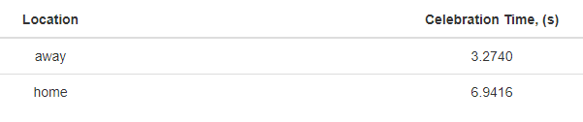
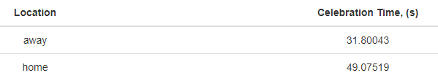
Home games had higher celebration times.
Jazz home games had 3.7 s longer celebration times
RSL home games had 17.2 s longer celebration times
Jazz Away vs Home Game Celebration Time
RSL Away vs Home Game Celebration Time
Notes:
Another point of interest was how home games and away games differed. If you have ever seen or been to an away game, you would know that there are significantly less fans that show up from your team. After comparing the celebration time averages, home games celebration time lasted longer for both teams. What is most interesting is by how much. The cheering difference for both teams is greater than 1 standard deviation, but less than 1.5 sd. The home team advantage still exists.

Slide 8
Summary
Relatively strong evidence shows that on average 1 RSL point is worth 67-98 Jazz Points.
Relatively strong evidence shows that on average RSL fans cheer 6-10 times longer than Jazz Fans.
There is little to no correlation of point number to cheering length for Utah Jazz fans.
Seemingly no correlation between point number and cheering length for RSL fans.
Our sample means had significant differences in average cheering times depending on if the team was playing away or at home.
Notes:
One of the limitations to our study was how the data was collected. As mentioned?, the celebration time data had the most restrictions since we had to determine the time of celebration ourselves with stopwatches. Other limitations could include the range of years from which we gathered our data, to see how random our data actually was.
But in the end, our analysis shows that RSL fans do indeed cheer in much longer than Jazz fans. Note that these results do not extend to all MLS and NBA teams. This could be one way we could broaden our study in the future. We found that the primary reason is the NUMBER of points scored per game, however, the ORDER of points did not affect the celebration.We also found that the WHEN the points are scored in the game does not influence the celebration, but WHERE the points are scored does.
Thank you for your time and are there any questions?

